Slide 1
SwiftUI
Part 2 – Global Modifier for UI Component View, Part 1
iCodeWave Community

Slide 2

Today’s Agenda
What is Global Modifier?
Padding
Frame
Navigation Stack
Navigation Title
Foreground Style
Background Style
Font
Custom Font
Font Weight
Line Limit
Line Spacing
Multiline Text Alignment
Hidden
iCodeWave Community

Slide 3

What is Global Modifier?
Global Modifier is a modifier that usually modifies View either the design or logical business
iCodeWave Community

Slide 4
Global Modifier for Component View
Padding
To have spacing between border and content
To use dynamic size, use .padding() without give additional parameter
iCodeWave Community

Slide 5
Global Modifier for Component View
Frame
To specify width and height of Component View
To apply, use .frame()
SwiftUI offered several parameter, such as: minWidth, idealWidth, maxWidth, minHeight, idealHeight, maxHeight, alignment
To maximize frame size we can use either maxWidth or maxHeight to achieve bound-size frame
iCodeWave Community

Slide 6
Global Modifier for Component View
Navigation Stack
To enable navigation and switching between struct View (eg: transition from View A to View B)
How to apply? Simply use NavigationStack {}
To enable navigation-related function (eg: toolbar item, navigation item, segue to another view, etc)
Must be embed on very first of View (the parent of View)
You can add another NavigationStack in child of View, but sometimes bug appear (nobody knew)
Better embed NavigationStack into #Preview closure, except the parent View must placed into var body
iCodeWave Community

Slide 7
Global Modifier for Component View
Navigation Title
To give current page View a title
To enable title, firstly you must wrap the NavigationStack {} and put .navigationTitle() right before closing bracket
You can still achieve this modifier if you put NavigationStack {} into #Preview closure
iCodeWave Community

Slide 8
Global Modifier for Component View
Foreground Style
To give accent color of content in a View use .foregroundStyle() followed by modifier Color
In Text View, is used to change the color of text
In Button, is used to change the color of text (not the background)
If we put this modifier under Stacking the entire Stack will have same content color
iCodeWave Community

Slide 9
Global Modifier for Component View
Background Style
To give background color of a View
the .background() modifier should be placed on last position of any other modifiers to ensure fill entire background of View
iCodeWave Community

Slide 10
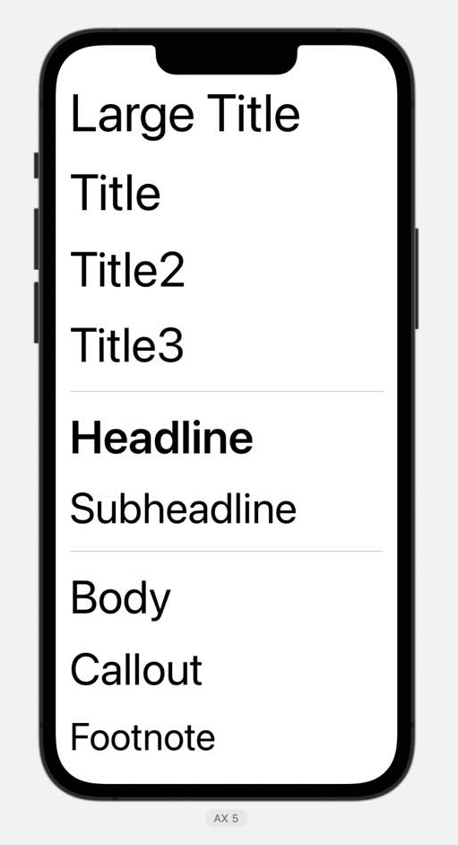
Global Modifier for Component View
Font
To change font size globally in a Text View or anything related to ‘text’
To use default font (San Francisco) and adjust size, use .font(.??) followed by modifier and sizing based on picture beside (eg: .font(.headline))
iCodeWave Community

Slide 11
Global Modifier for Component View
Custom Font
To use custom font that provided by Xcode, you can use .font(Font.custom("?", size: ??))
Type the string correctly, otherwise font won’t appear
iCodeWave Community

Slide 12
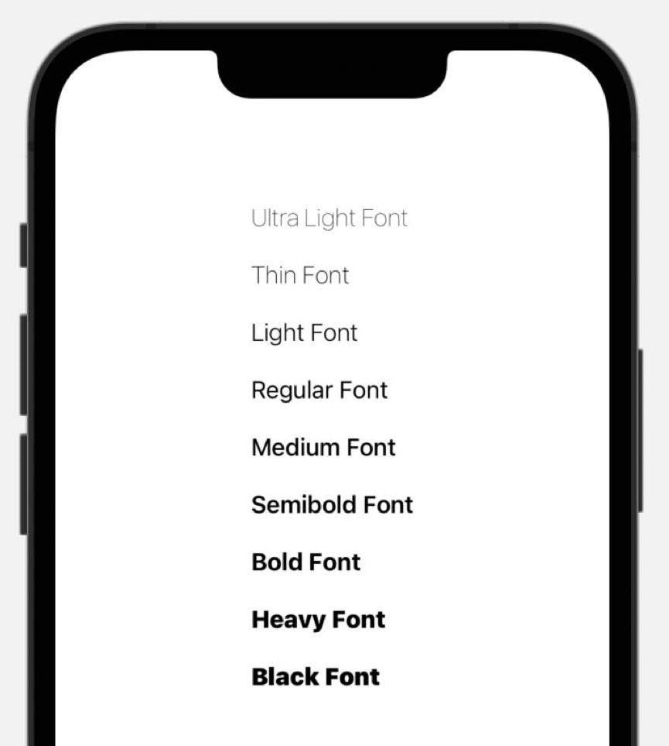
Global Modifier for Component View
Font Weight
To change thickness of font, simply use .fontWeight(.??)
There are several type of font weight, list provided in picture beside
iCodeWave Community

Slide 13
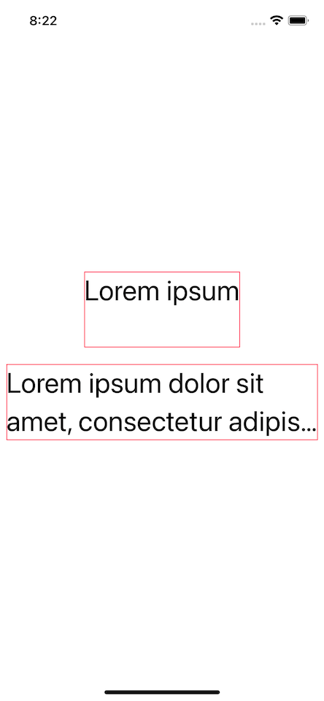
Global Modifier for Component View
Line Limit
To limit the text so it’s not spilled, use .lineLimit() followed by number Int
iCodeWave Community

Slide 14
Global Modifier for Component View
Line Spacing
To have spacing between text line in a string, use .lineSpacing() followed by number Int
iCodeWave Community

Slide 15
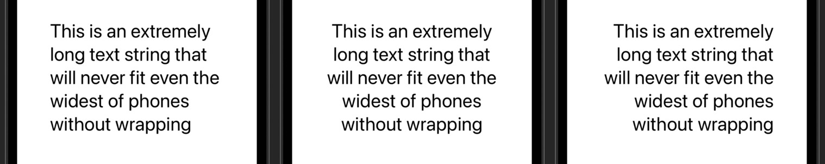
Global Modifier for Component View
Multine Text Alignment
To control text behaviour just like our Report in College, use .multilineTextAlignment()
Parameter we can choose one of following: leading, center, or trailing
iCodeWave Community

Slide 16
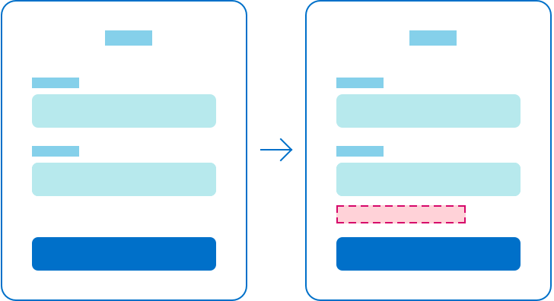
Global Modifier for Component View
Hidden/Opacity
To hide View we don’t want to need, simply use .hidden() or .opacity(Double) modifier to hide View from appearance, not to remove and change layout
iCodeWave Community

Slide 17
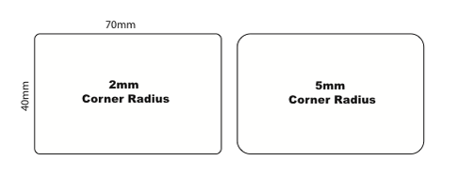
Global Modifier for Component View
Corner Radius
To round a View, simply use .cornerRadius(Double)
iCodeWave Community

Slide 18
Thanks For Your Attendance Today!
iCodeWave Community

